Slide 1
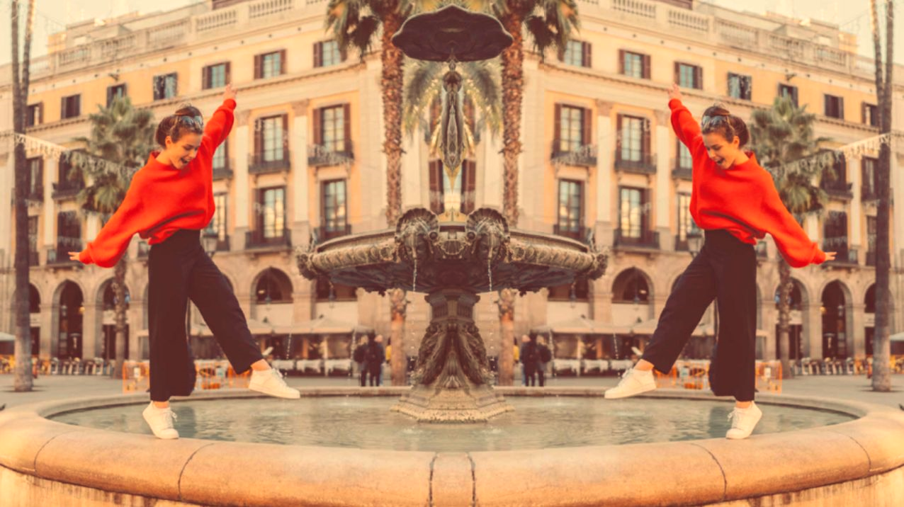
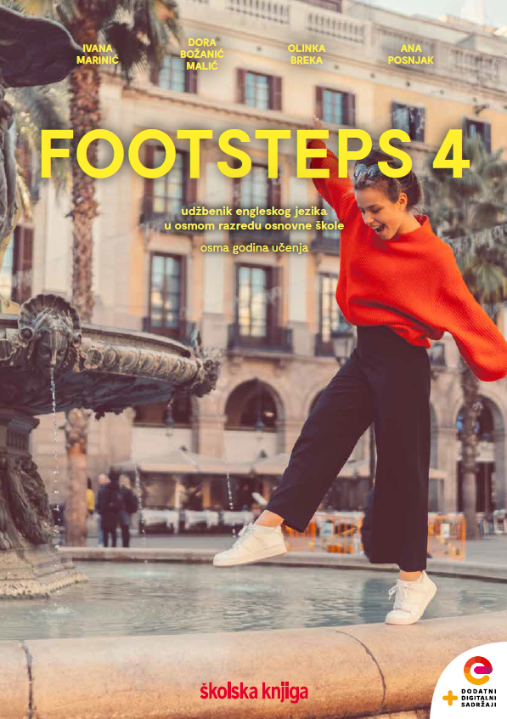

UNIT 7; Choices
Lesson 2; Super food

Slide 2
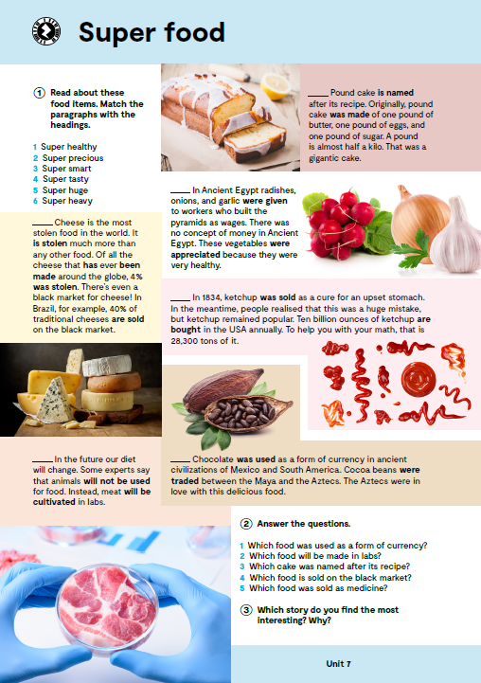
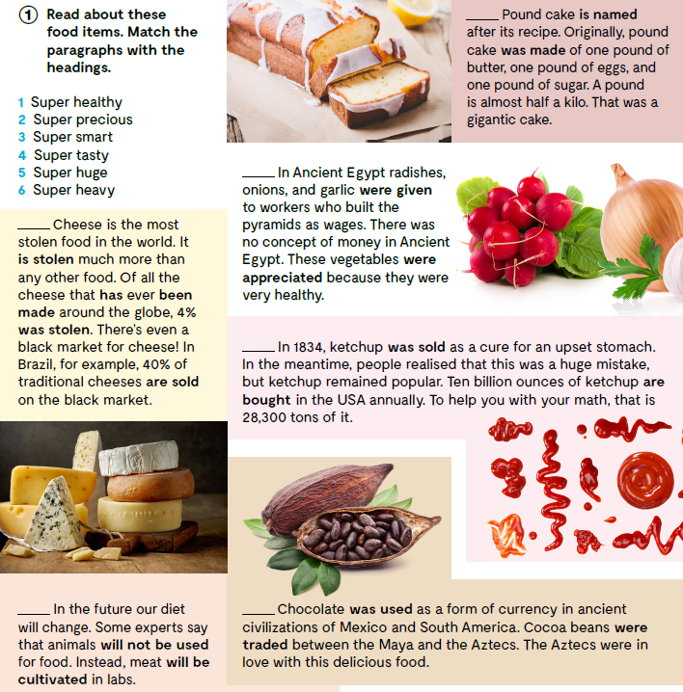
6
Open your book, page 110.
1
2
5
3
4

Slide 3

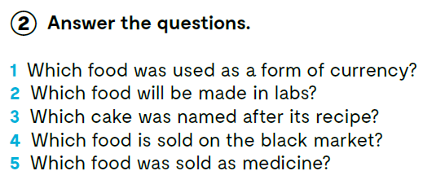

1 Chocolate was used as a form of currency.
2 Meat will be made in labs.
3 Pound cake was named after its recipe.
4 Cheese is sold on the black market.
5 Ketchup was sold as medicine.

Slide 4
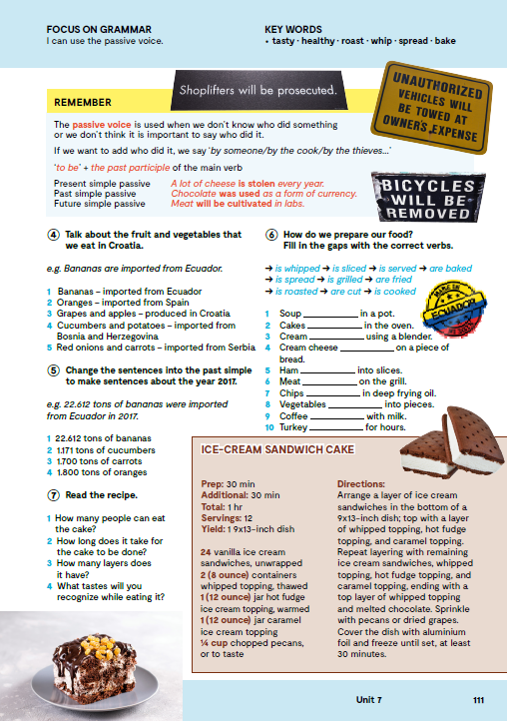
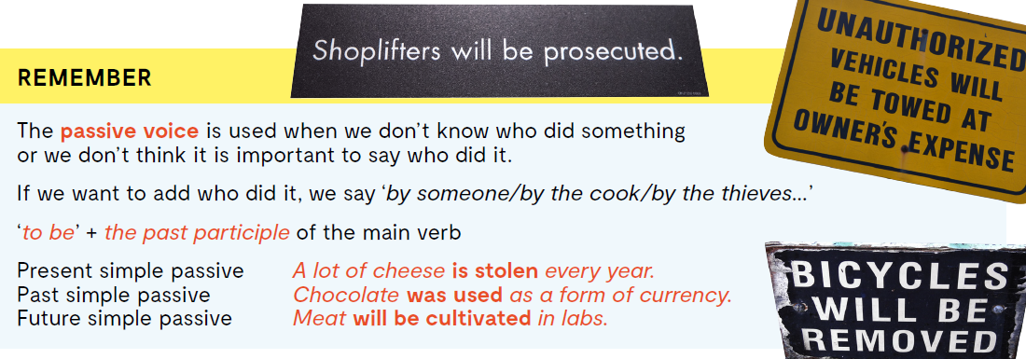

Slide 5

Pogledaj REMEMBER BOX kako bi naučio PASSIVE VOICE!
PASSIVE VOICE koristimo kada nam je sama radnja važnija od toga tko je radnju izvršio ili kada ne znamo tko je vršitelj radnje.
Ako ipak želimo imenovati vršitelja radnje koristit ćemo ‘by someone/by the cook/by the thieves…’
TO BE + PAST PARTICIPLE glavnog glagola
Present simple passive A lot of cheese is stolen every year.
Past simple passive Chocolate was used as a form of currency.
Future simple passive Meat will be cultivated in labs.

Slide 6
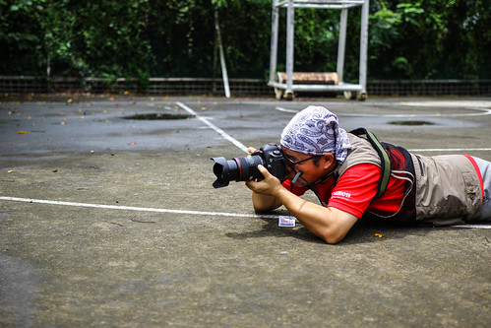
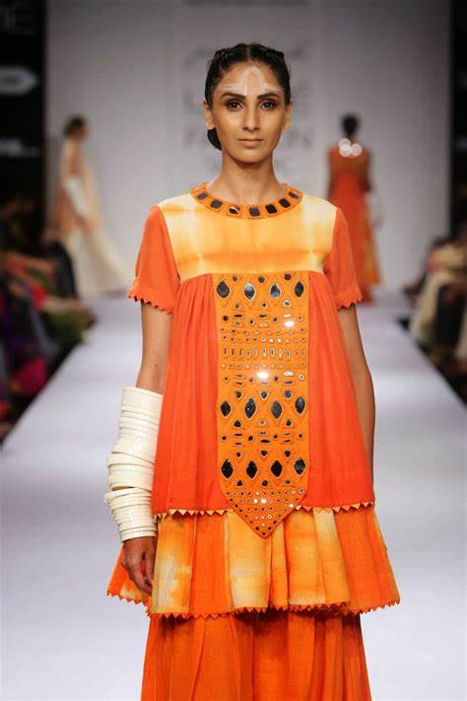




PASSIVE VOICE
The photographer
photographs .
⇨ ACTIVE VOICE (subjekt vrši radnju)
photographs .
the model
SUBJECT
OBJECT
VERB / glagol
PRESENT SIMPLE
PASSIVE VOICE ⇨ (subjekt „trpi” radnju;
fokus je na radnji, a ne na
osobi koja ju vrši)
VERB / glagol
SUBJECT
PAST PARTICIPLE
PASSIVE AGENT
The model
photographed
is
by
the photographer.

Slide 7

The model is photographed by the photographer.
PRESENT SIMPLE of the VERB TO BE
(am/is/are)
PAST PARTICIPLE (VERB + d/ed; or the 3rd column)
SUBJECT
BY
PASSIVE AGENT
kada je subjekt aktivne (ACTIVE VOICE) rečenice PEOPLE, SOMEONE, SOMEBODY, THEY… onda ga u pasivnoj (PASSIVE VOICE) rečenici možemo izbaciti
People use mobile phones.
Mobile phones are used by people.
kada je subjekt aktivne (ACTIVE VOICE) rečenice OSOBNA ZAMJENICA U NOMINATIVU (SUBJECT PRONOUN) onda ju u pasivnoj (PASSIVE VOICE) rečenici zamjenjujemo sa OSOBNOM ZAMJENICOM U AKUZATIVU (OBJECT PRONOUN)
She teaches my sister.
My sister is taught by her.

Slide 8
ACTIVE VOICE: The Wright brothers invented airplanes.
PASSIVE VOICE:
Airplanes were invented by the Wright brothers.
PAST SIMPLE FORM OF THE VERB TO BE + PAST PARTICIPLE
PAST SIMPLE

Slide 9
ACTIVE VOICE: Sandy will write the email.
PASSIVE VOICE:
The email will be written by Sandy.
FUTURE SIMPLE FORM OF THE VERB TO BE + PAST PARTICIPLE
FUTURE SIMPLE
More info: https://youtu.be/iGNux1MF6Ko
Check what you have learnt. https://www.bookwidgets.com/play/9CA7F97

Slide 10
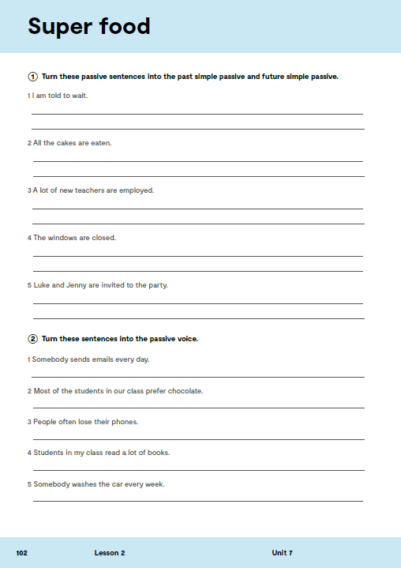
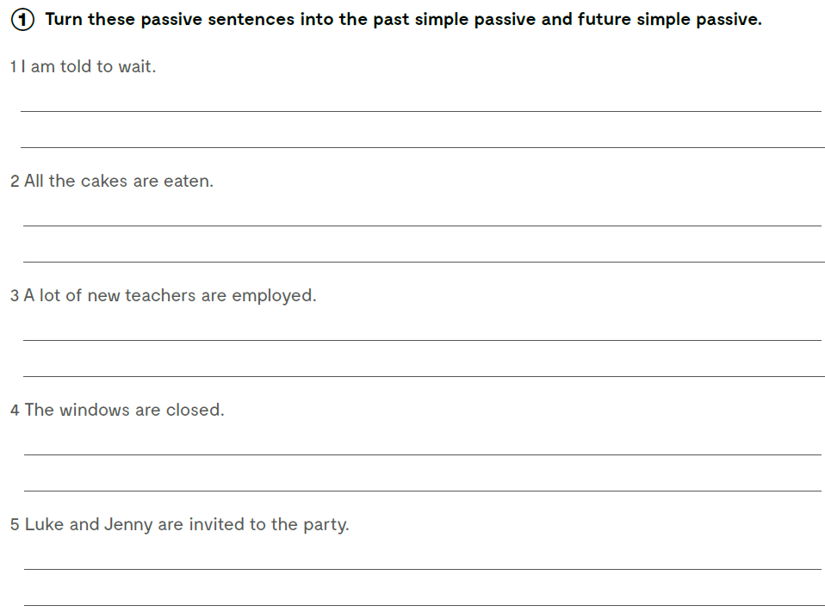
Open your exercise book, page 102.
I was told to wait.
I will be told to wait.
All the cakes were eaten.
All the cakes will be eaten.
A lot of new teachers were employed.
A lot of new teachers will be employed.
The windows were closed.
The windows will be closed.
Luke and Jenny were invited to the party.
Luke and Jenny will be invited to the party.

Slide 11
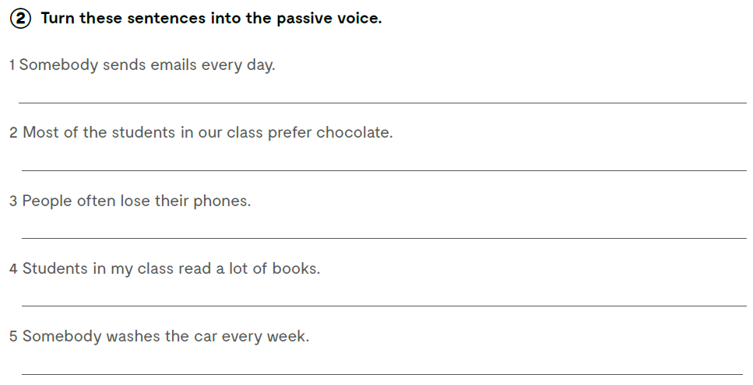
Turn these sentences into the passive voice. Prepiši rečenice u njihovom pasivnom obliku.
Emails are sent every day.
Chocolate is prefered by most of the students in our class.
Phones are often lost.
A lot of book are read in my class.
The car is washed every week.

Slide 12

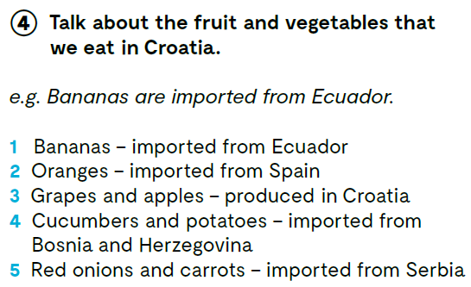
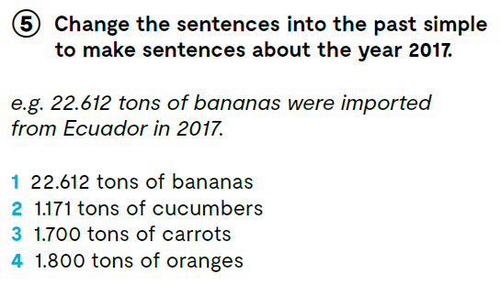
2 Oranges are imported from Spain.
3 Grapes and apples are produced in Croatia.
4 Cucumbers and potatoes are imported from Bosnia and Herzegovina.
5 Red onions and carrots are imported from Serbia.
Change the sentences into the past simple to make sentences about the year 2017.
2 1.171 tons of cucumbers were imported from Bosnia and Herzegovina in 2017.
3 1.700 tons of carrots were imported from Serbia in 2017.
4 1.800 tons of oranges were imported from Spain in 2017.

Slide 13

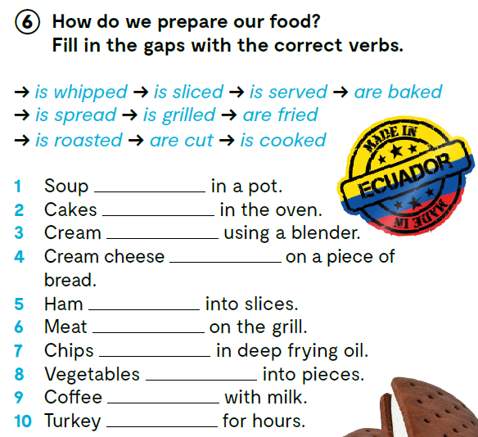
is cooked
are baked
is whipped
is spread
is sliced
is grilled
are fried
are cut
is served
is roasted

Slide 14
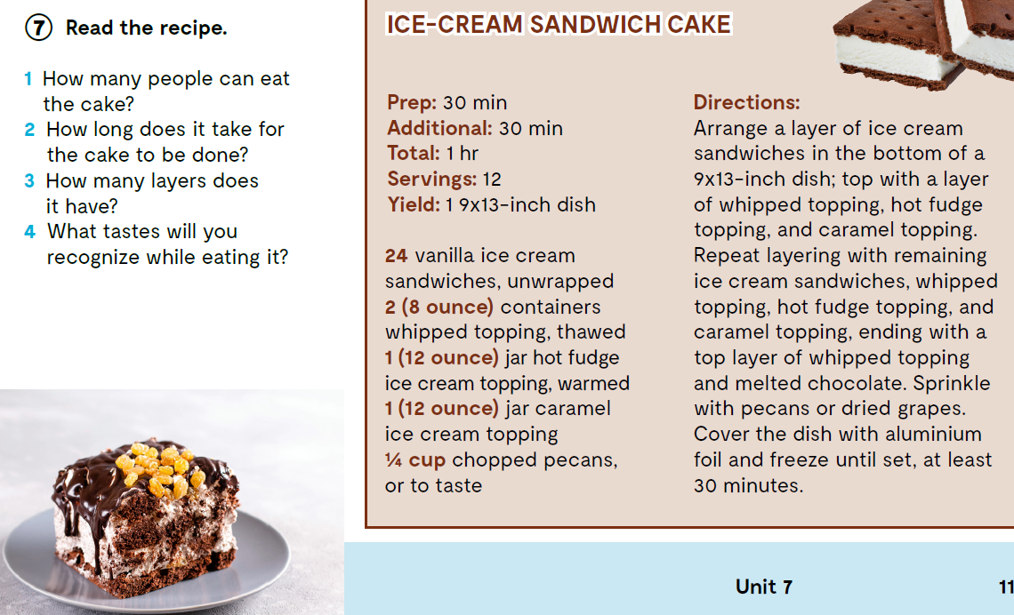

Slide 15
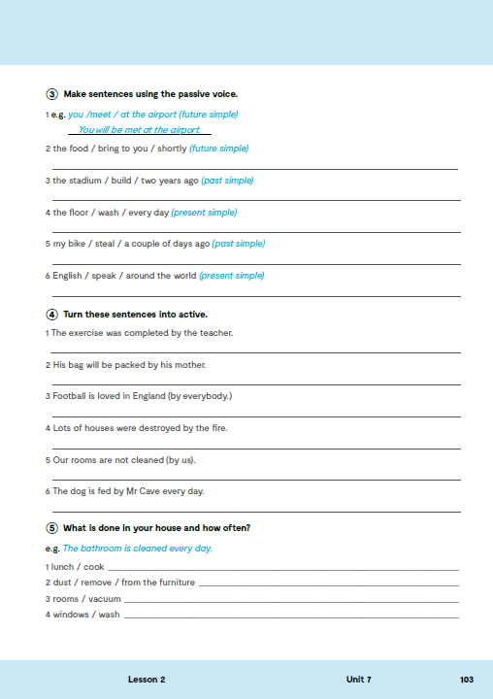

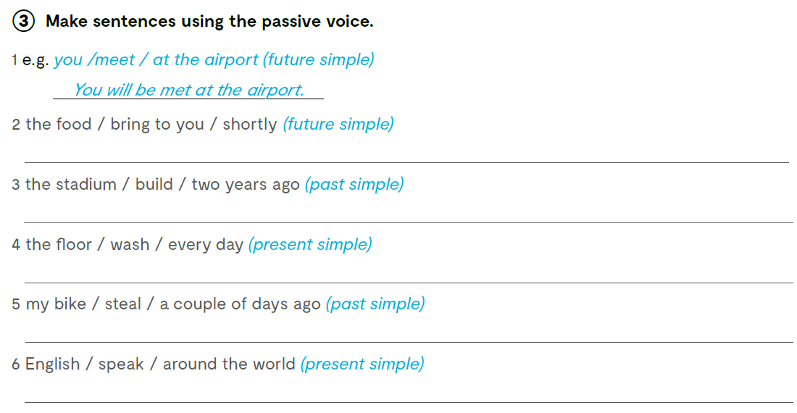
Open the following link and then click on LEARN MORE! https://www.e-sfera.hr/dodatni-digitalni-sadrzaji/7780aad3-7b6a-4509-b1d7-572d96a30432/
Food Fusion
Read the texts and do the tasks bellow the text. Pročitaj tekstove i riješi zadatke ispod teksta.
The food will be brought to you shortly.
The stadium was built two years ago.
The floor is washed every day.
My bike was stolen a couple of days ago.
English is spoken all around the world.

Slide 16
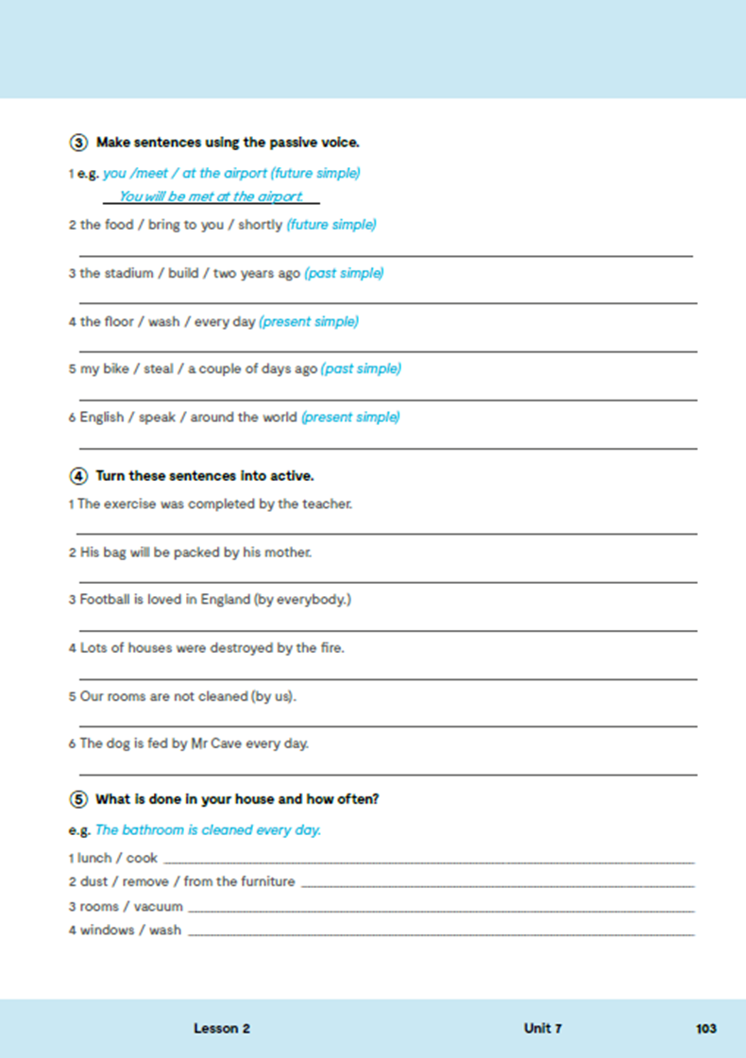
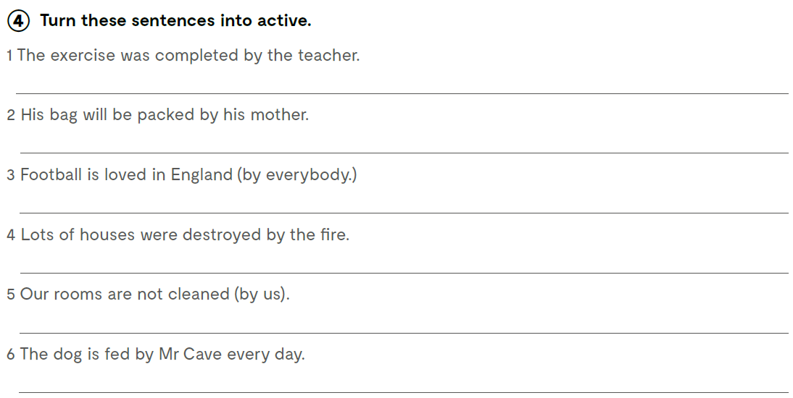
The teacher completed the exercise.
His mother will pack the bag.
Everybody loves football in England.
The fire destroyed lots of houses.
We do not clean our rooms.
Mr Cave feeds the dog every day.

Slide 17
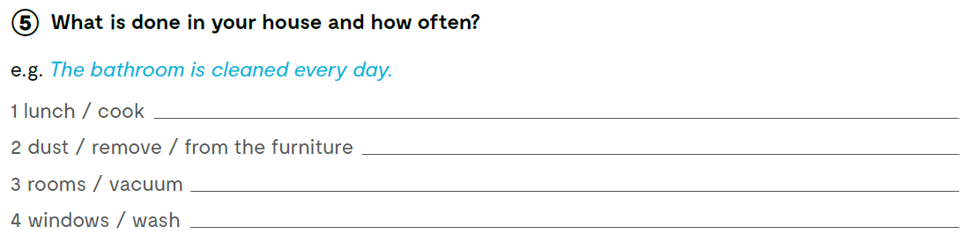
Lunch is cooked every day.

Slide 18
Turn the directions into the passive voice.
Easy One Bowl Fudgy Cocoa Brownies
Ingredients:
1/2 cup melted butter or 1 stick, 1/2 cup unsweetened cocoa, 1 cup sugar see note, 2 large eggs, 1 teaspoon vanilla, 1/2 cup flour, 1/4 tsp salt leave out if using salted butter
Directions
Preheat oven to 350°F. Grease an 8x8 square pan or line with foil and set aside.
In a medium bowl combine melted butter, cocoa, and sugar and stir until fully dissolved.
Add eggs one at a time, then vanilla, and stir until well combined.
Stir in flour and salt until the flour is fully combined. Be careful not to overmix mix.
(optional) fold in 1 cup of nuts, raisins, chocolate chips or anything you desire.
Spread in pan and bake for approximately 20-22 minutes or until the center is slightly set. Be careful not to over-bake!
Cool completely, then cut into 9 large squares or 16 small squares (I cut mine into 16).

